Slide 1
OpenStack SWIFT – Tape Library Connector (TLC)
Object Storage with SWIFT TLC

Slide 2
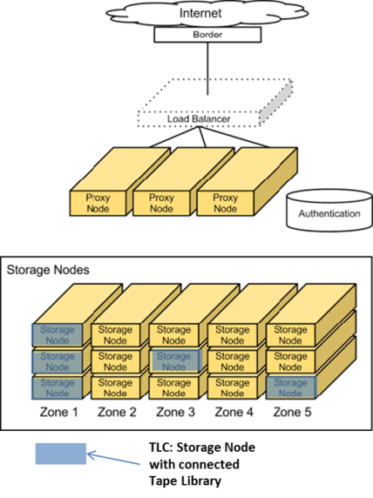
Why do we need SWIFT TLC?
Long term data storage requirements continue to grow rapidly
OpenStack is quickly becoming the standard open-source cloud computing solution
SWIFT is OpenStack’s highly scalable object storage system to store large amounts of unstructured data
Tape Libraries provide the best value for long-term data storage
SWIFT TLC makes tape look like a standard disk storage node
SWIFT TLC enables simple, seamless, transparent tape library integration into an OpenStack SWIFT environment

Slide 3
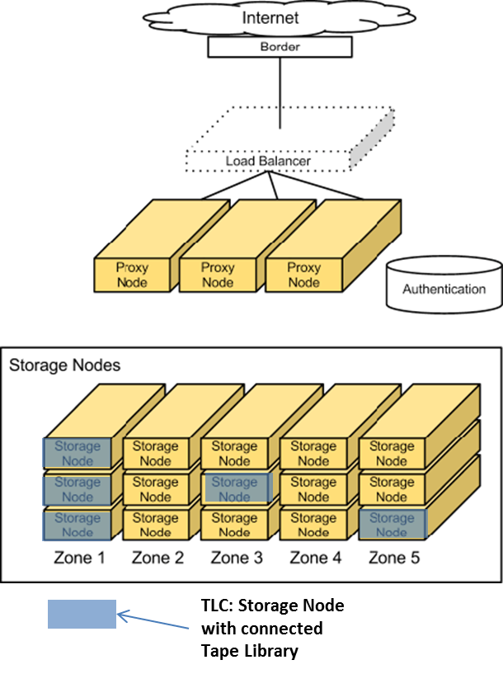
Overview – SWIFT Tape Library Connector (TLC)
SWIFT Object Storage TLC:
Connects a Tape Library as a standard Storage Node into an OpenStack SWIFT Object Storage environment
Integrates the library seamlessly into a standard SWIFT environment with no modification to core SWIFT code
Supports standard SWIFT Object Storage functionality and operations (Upload, Download, Delete, Replication, Auditing, Recovery, Versioning, Multi Nodes, Zoning)
Powerful Tape-specific Auditing Handler to support SWIFT auditing for Tape
Uses LTFS to store objects on tape

Slide 4
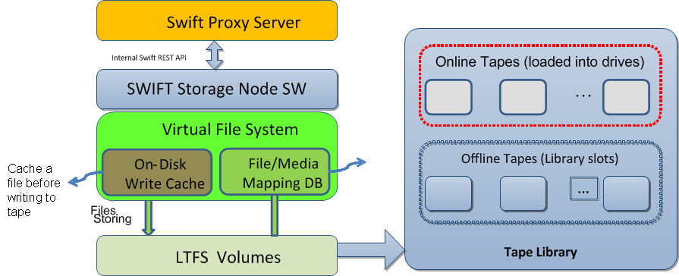
Overview – TLC Architecture

Slide 5
Overview – TLC Virtual File System (VFS)
TLC VFS:
Based on FUSE to span the storage capacity of tapes to one large connected file system
The VFS root folder becomes the mount point for a standard SWIFT Storage Node (exactly like a disk based Storage Node)
Uses LTFS to store Object data (files) directly on tape in a open format
Has a transparent, disk based, fast and scalable Data Cache to buffer files before they are written to tape and supporting fast read access
Stores all VFS file metadata on a disk based Metadata Cache
Keeps all SWIFT hashes, accounts and containers on disk
Tape

Slide 6
Cofigure SWIFT to use TLC
Modification | File | Comment(Purpose)
increase time out for proxy server [app:proxy-server] node_timeout = 300 | /etc/swift/proxy-server.conf | Allow longer read response times for the SWIFT nodes
Add line “vs_cache_dir = /srv/vs_cache” | TLC node: object-server.conf | Set the data cache folder for TLC customized SWIFT auditor handler.
Update entry in [app:object-server] from use = egg:swift#object to use = egg:vs_auditor#vs_object | TLC node: object-server.conf | Register the TLC Auditor to be used for SWIFT, Python egg vs_auditor will be installed by TLC auditor installer
Patch standard SWIFT object auditor source file | /usr/lib64/python2.6/site-packages/swift/obj/auditor.py | Patch this SWIFT auditor source file to use TLC Tape Auditor for TLC nodes. Done by TLC Auditor installer script
Add TLC node to SWIFT ring e.g. “swift-ring-builder object.builder add r1z3-172.16.56.5:6000/vsnode 7000” | Proxy Server: /etc/swift/object.builder /etc/swift/container.builder /etc/swift/account.builder | Connect the TLC VFS (TLC:/srv/node/vsnode) to SWIFT

Slide 7
SWIFT TLC Value
Extremely simple integration of Tape Libraries into SWIFT environments
Simple installer
Very lean architecture
no knowledge about SCSI and Tape libraries necessary
No modification on OpenStack SWIFT necessary
No proprietary functionality, uses all default functionality from SWIFT (auditing, replication, load balancing, recovery, zoning, …)
Good vertical scale out support – just expand tape library to extend capacity or add tape drives to tape library to increase performance
Good horizontal scale out support – just add more TLC storage nodes to SWIFT environment
Fits well into existing mixed environments based on disk based Storage Nodes
Support for all types of tape libraries, vendor independent, no limitation in supported capacity or drive quantity, support for SAS and FC as well

Slide 8
SWIFT TLC Evaluation Package
BDT SWIFT TLC Installer Package
Installs TLC software on existing SWIFT Storage node
Configures SWIFT to use TLC
BDT Test Scripts
Scripts which could be used for intensive testing
Tool to demonstrate tape specific SWIFT file auditing and recovery
SWIFT TLC Installation Guide
SWIFT TLC Overview Presentation

Slide 9
SWIFT TLC Evaluation Setup
Setup default OpenStack SWIFT environment with 1 Proxy Server and 3 Storage Nodes, configure SWIFT and verify functionality, use CentOS 7 as Server OS
Add SAS HBA (e.g. LSI 6Gb SAS 9205-8e) with LSI chip and Tape Support (no RAID disk controller) to Storage Node 3 and attach Tape Library, verify that Tape Library and Tape Drives will be detected from OS (lsscsi –g )
Possible Hardware Configuration for TLC server:
Data Cache: RAID0 1-2TB (SSD recommended)
Metadata: RAID5 50-100GB (SSD recommended)
Memory: 16GB
CPU: Quad-Core (e.g. XEON X5)
Tape library: tape library from HP, IBM, DELL, Fujitsu, Overland, Spectra Logic, actidata, BDT
Tape drives: 1-2
Create Storage Volumes for Data Cache and Metadata Cache and mount to this folder
Data Cache: /opt/VS/vsCache/diskCache
Metadata: /opt/VS/vsCache/meta
Install BDT TLC software and SWIFT service using installer (refer SWIFT_TLC_Quickstart document)
Installer will install everything automatically and configures the SWIFT Storage Node configuration accordingly
Add TLC VFS root folder (/srv/node/vsnode) to SWIFT ring configuration on Proxy Server and distribute modified SWIFT Ring configuration files to all Storage Nodes
Detailed Information available in BDT SWIFT_TLC _QuickStart.pdf

Slide 10
SWIFT TLC Evaluation Setup Overview
Default OpenStack SWIFT environment (ideally based on CentOS 7)
1 OS Controller Node with Keystone and SWIFT Proxy Server running (VM possible)
2 default SWIFT Storage Nodes (disk based) (VM possible)
Default SWIFT Storage Node + BDT SWIFT Tape Library Connector (TLC) with attached Tape Library (MultiStak or FlexStor) (needs to be a physical server), OS: CentOS7

